Slide 1
Deep Learning for
Recommender Systems
Massimo Quadrana
16-18 January 2017

Slide 2

Disclaimer
What this presentation is:
An overview of Deep Learning and its applications in Recommender Systems
What this presentation is not:
A detailed introduction to Neural Networks and Deep Learning techniques

Slide 3

Heads-up!
Paper on DL for Recsys

Slide 4
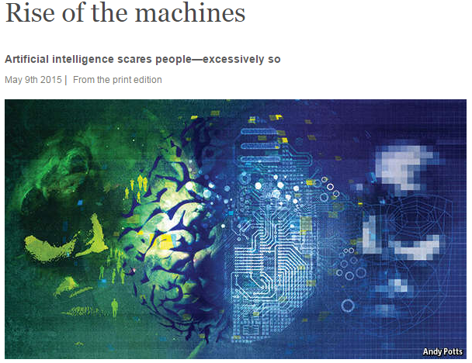
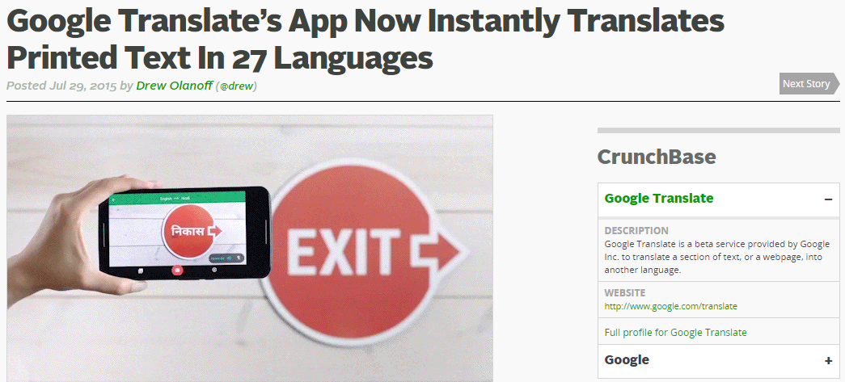
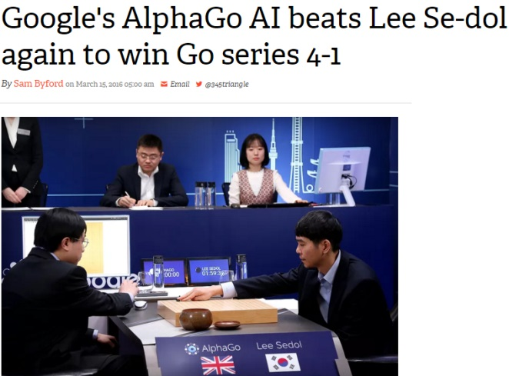
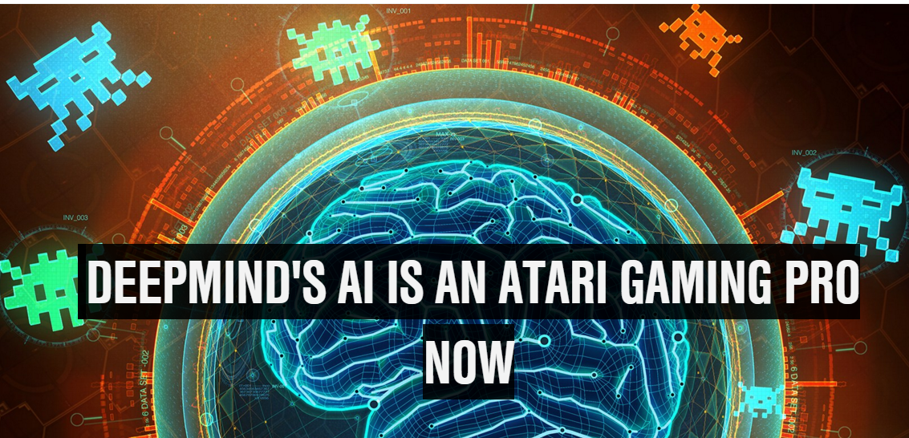
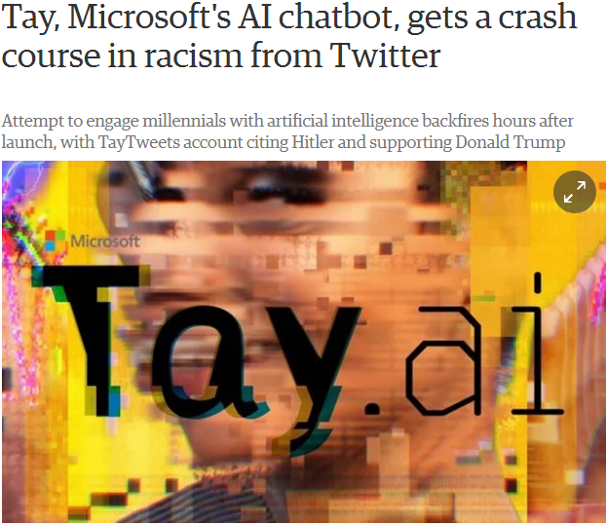
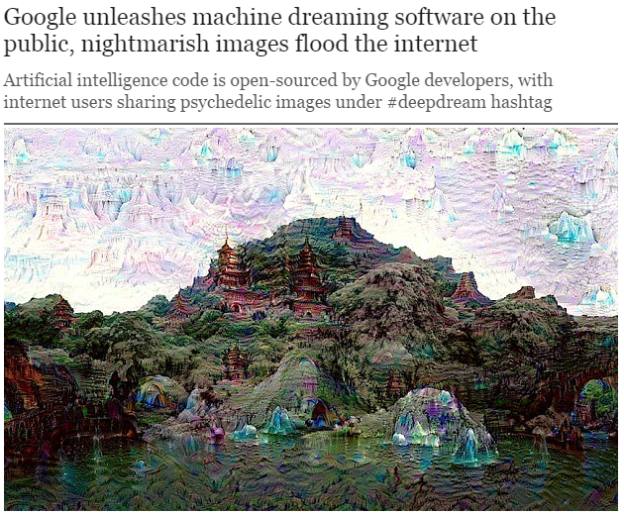
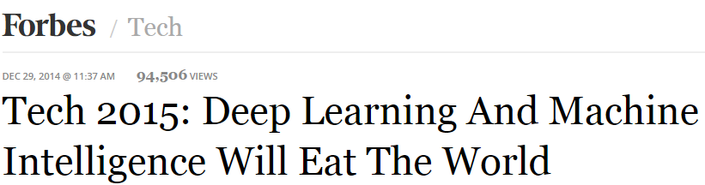
Deep Learning in the News
(Slide taken from Balazs Hidasi’s presentation “Deep Learning to the Rescue”, Budapest Recsys Meetup, 2016)

Slide 5
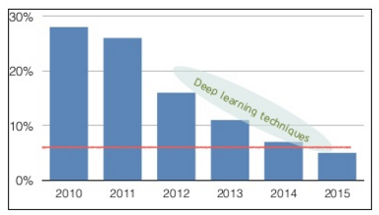
Why going deep?
ImageNet challenge error rates (red line = human performance)

Slide 6
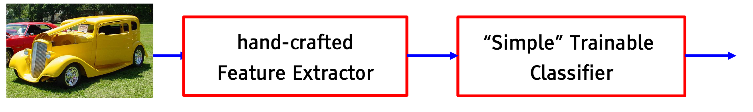
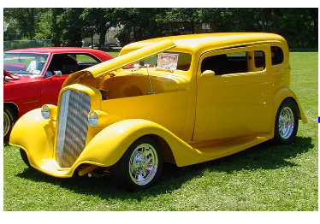
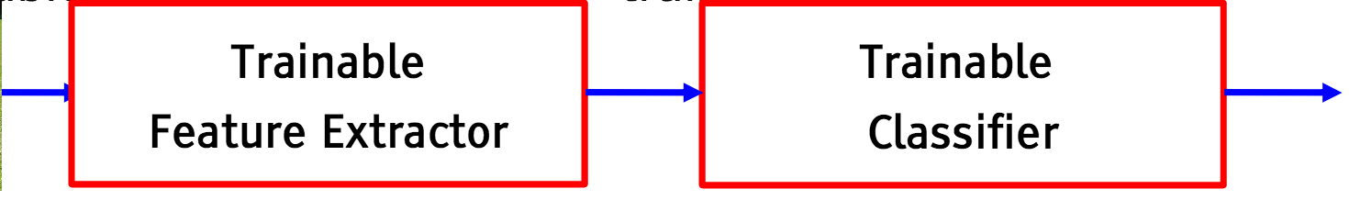
Why going deep?

Slide 7
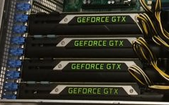
Why is it happening now?
Actually it is not :-) → first papers published in 1970s
Research breakthroughs
Vanishing gradients → layer-wise pretraining, non saturating activations
Difficult training → Adaptive training (Adagrad, Adam, RMSprop)
Overfitting → Dropout regularization
Increase in computational power
General Purpose GPUs

Slide 8
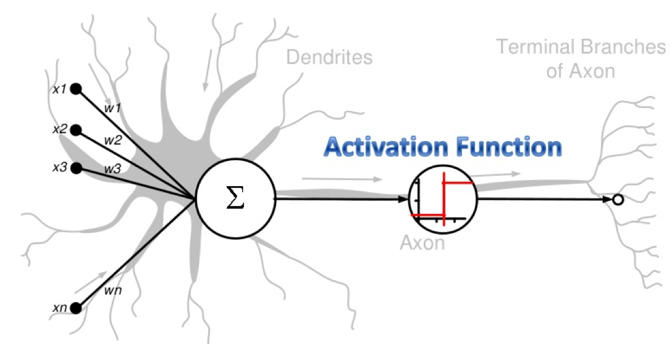
Neural model

Slide 9
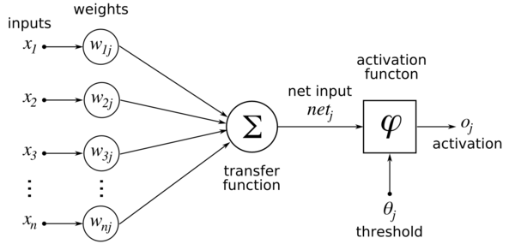
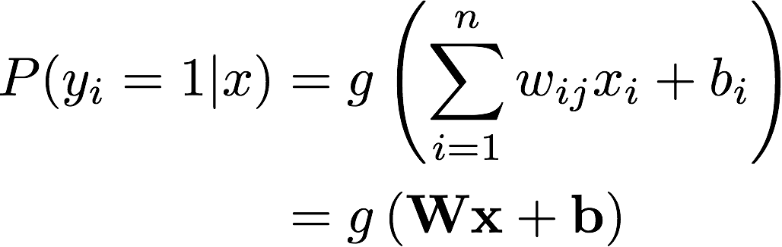
The neuron (a.k.a. unit)
g
y_{i}
b_{i}

Slide 10
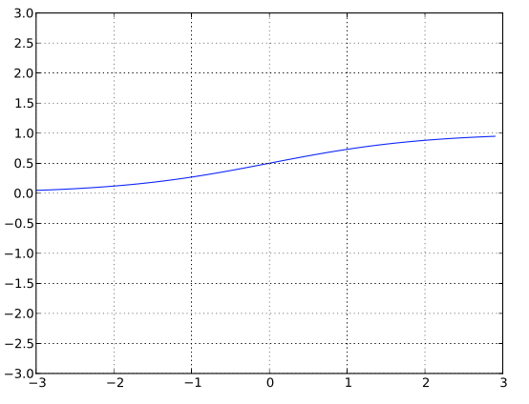
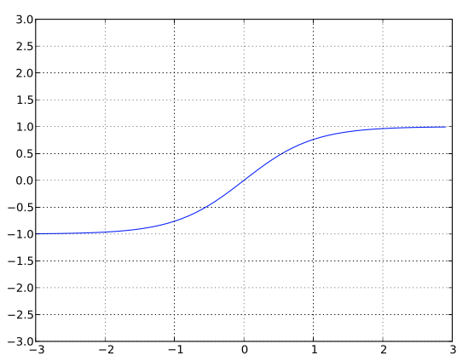
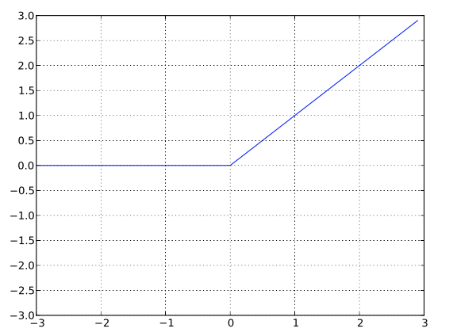
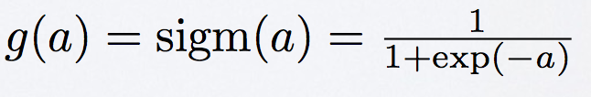
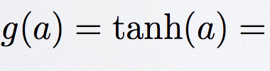
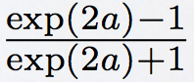
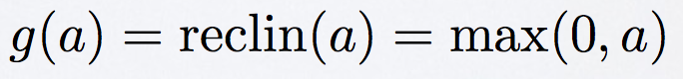
Activation functions
Sigmoid
Tanh
ReLU

Slide 11
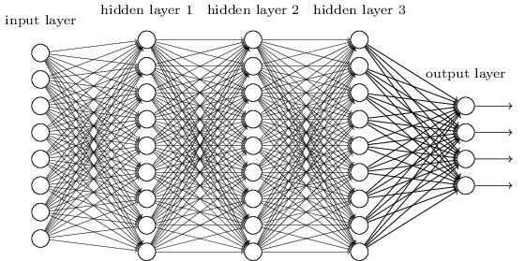
Feed Forward Neural Networks

Slide 12
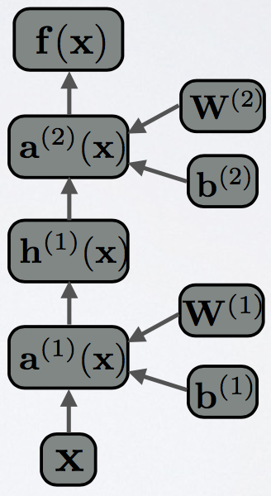
Flow graph
Forward propagation can be represented as a flow graph
Each box has a fprop function that computes the output of the box given its parents
Calling fprop of each box in order leads to forward propagation
Used by most DL libraries (e.g., Theano, TensorFlow)

Slide 13
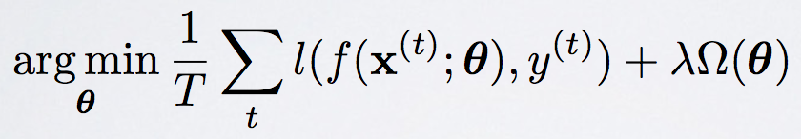
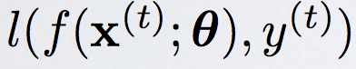
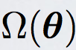
Learning
Empirical loss minimization
Is a loss function
metric we want to optimize (e.g., squared-error) or its smooth approximation (e.g, AUC → BPR, MRR → CLIMF)
Is a regularizer

Slide 14
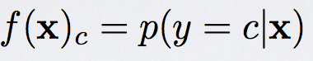
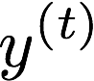
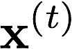
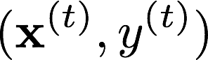
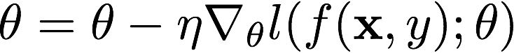
Learning
The neural network learns
We can maximize the probabilities of given the training data
Stochastic Gradient Descent (SGD):
For N epochs
For every training sample
compute

Slide 15
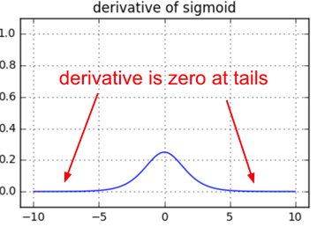
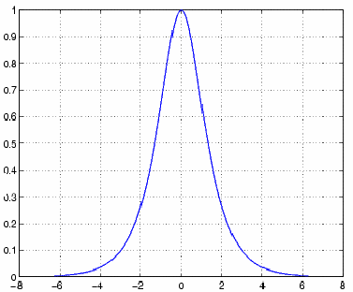
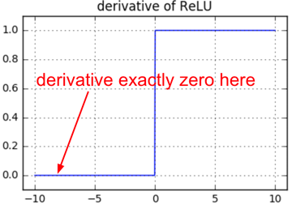
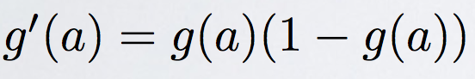
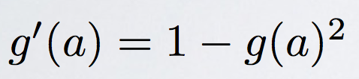
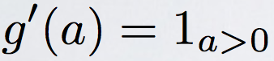
Activation functions - Partial derivatives
Sigmoid
Tanh
ReLU

Slide 16
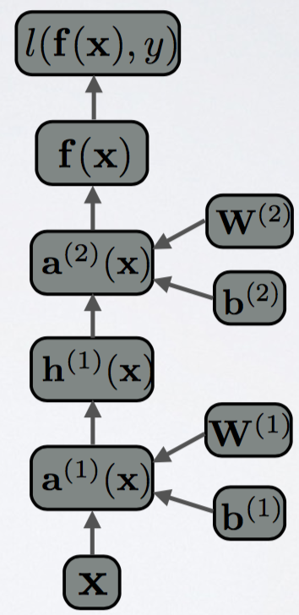
Backpropagation
Use the chain rule to compute gradients efficiently, top to bottom
In the flow graph, each box has a bprop function:
Computes the gradient of the loss wrt each parent
By calling bprop in reverse order we get the backpropagation
⇒ Automatic differentiation!

Slide 17
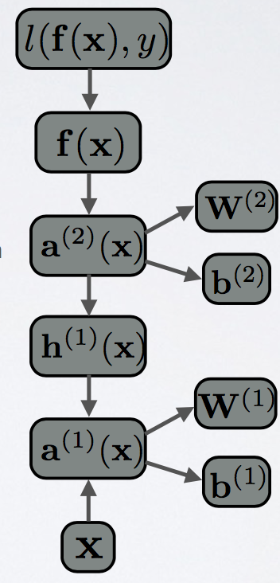
Backpropagation
Use the chain rule to compute gradients efficiently, top to bottom
Automatic differentiation:
In the flow graph, each box has a bprop function:
Computes the gradient of the loss wrt each parent
By calling bprop in reverse order we get the backpropagation

Slide 18
Why training deep nets is hard
ISSUES
Optimization is hard → underfitting
Gradients vanish through several layers
Saturated units block gradient propagation
Overfitting
Complex functions
DNNs have many parameters
Depending on the problem, one of the two situations dominates

Slide 19
Why training deep nets is hard
Solutions
Underfitting: better optimize
Use better optimization procedures
Use more data, train with GPUs
Overfitting: better regularization
Layerwise pretraining
Dropout
Other tricks: “smart” initialization, batch/layer normalization

Slide 20
Why training deep nets is hard
Solutions
Underfitting: better optimize
Use better optimization procedures
Use more data, train with GPUs
Overfitting: better regularization
Layerwise pretraining
Dropout
Other tricks: “smart” initialization, batch/layer normalization

Slide 21
SGD Tricks
Mini-batch SGD: update over mini-batches instead of 1 single example
More accurate estimate of the gradient
Leverage fast matrix/matrix ops
Momentum SGD: use exponential moving average of the previous gradients
Get through plateaus quickly by gaining “momentum”
Learn with adaptive learning rates
Adagrad, Adam, RMSprop

Slide 22


SGD Tricks

Slide 23
Why training deep nets is hard
Solutions
Underfitting: better optimize
Use better optimization procedures
Use more data, train with GPUs
Overfitting: better regularization
Layerwise pretraining
Dropout

Slide 24
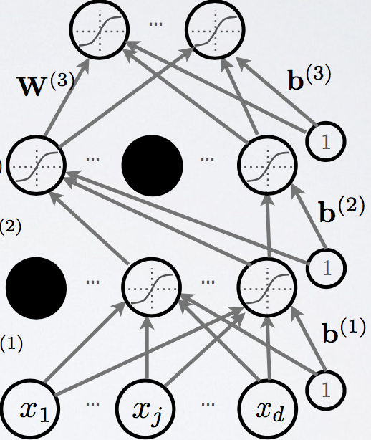
Dropout (Hinton,2012)
Remove hidden units stochastically
Reduce layer co-adaptation → better generalization

Slide 25
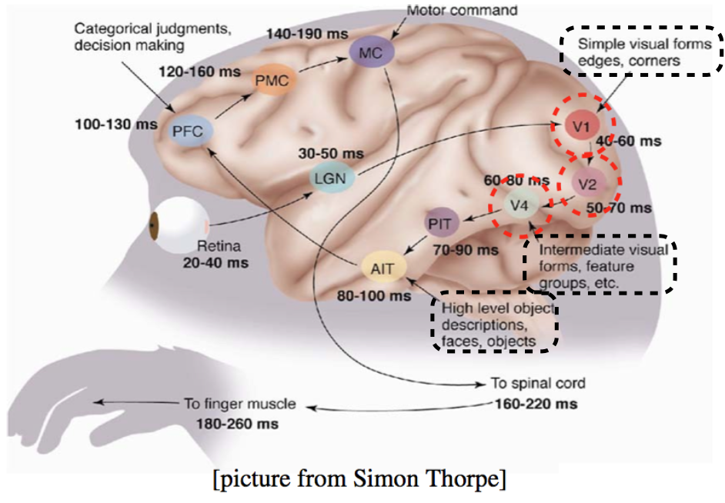
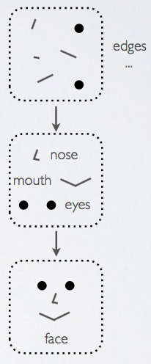
DL inspiration from the visual cortex

Slide 26

DL for vision, audio and text
some input with few assumption
… but data has structure!

Slide 27
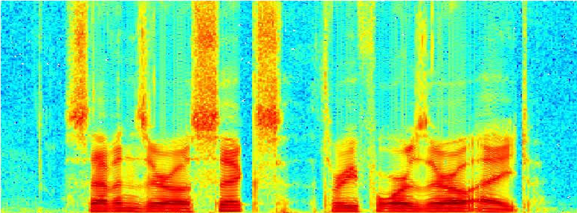
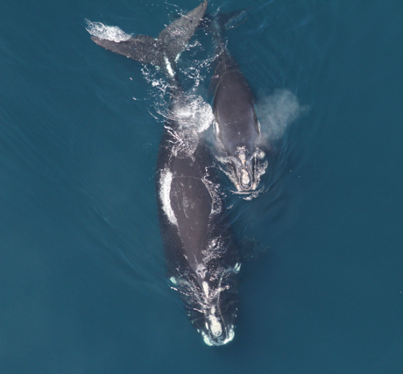
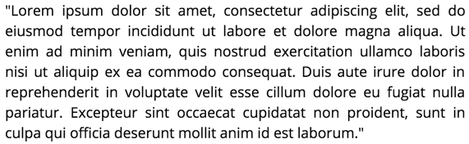
DL for vision, audio and text
Spectrograms
Text
Images

Slide 28
DL for vision, audio and text
Images

Slide 29
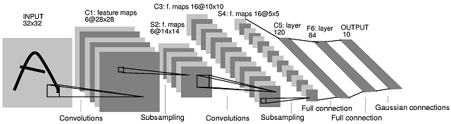
Convolutional Neural Networks (CNNs)
Gradient-based learning applied to document recognition [LeCun, Bottou, Bengio, Haffner 1998]

Slide 30
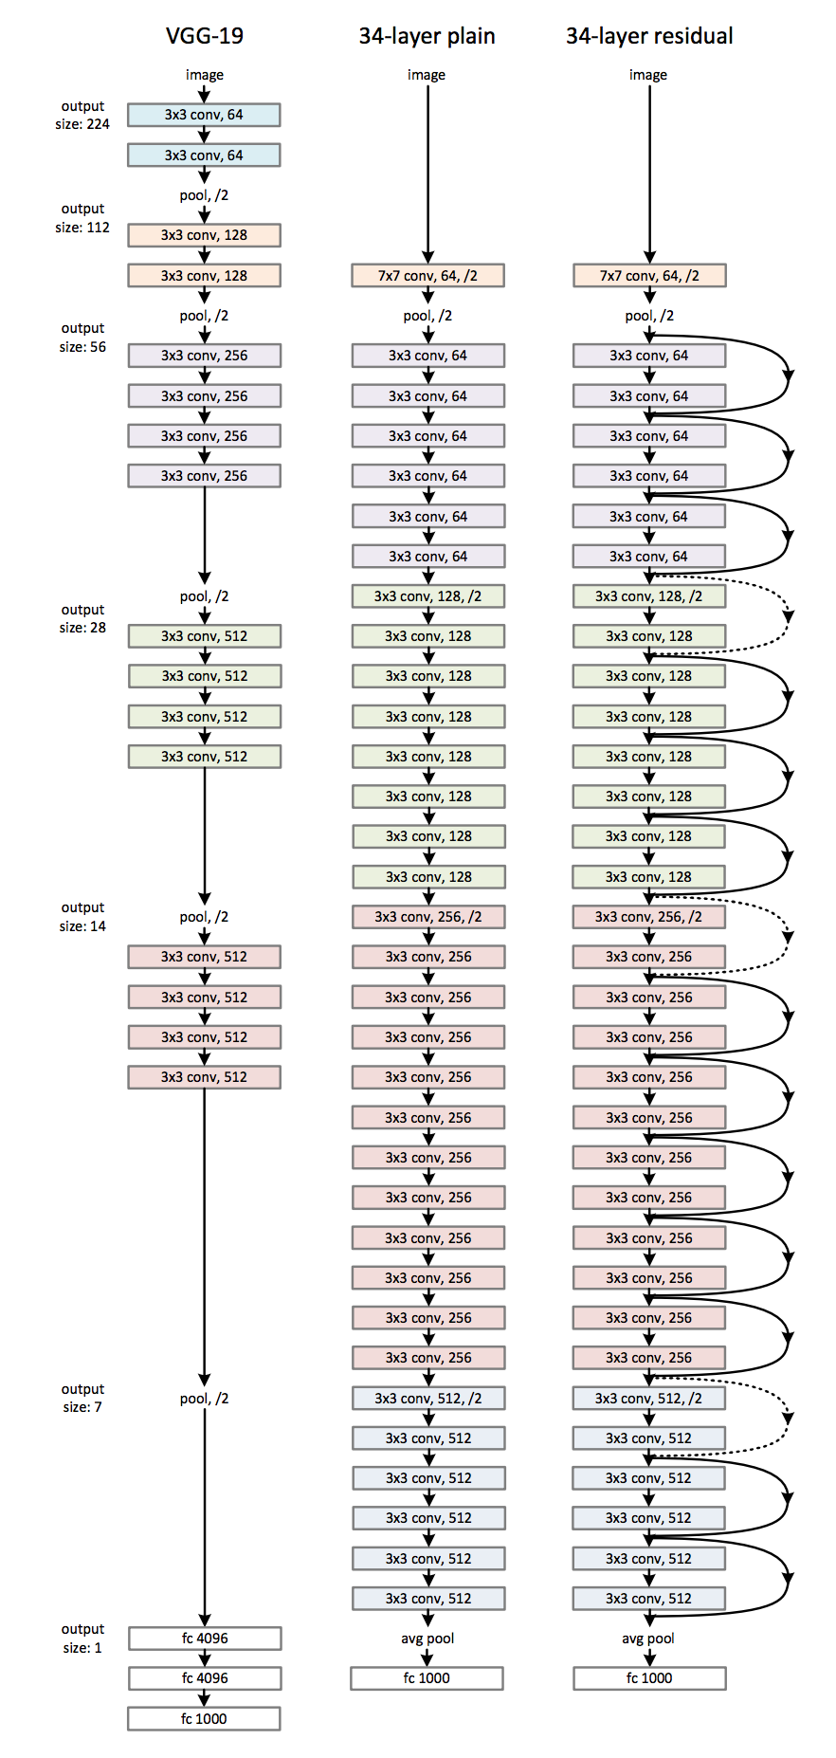


Modern CNNs
“ResNet” [He, 2015]
“AlexNet” [Krizhevsky, 2012]
“GoogLeNet” [Szegedy, 2014]

Slide 31
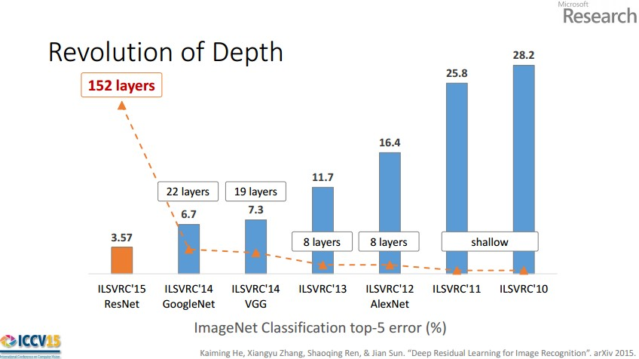

Slide 32
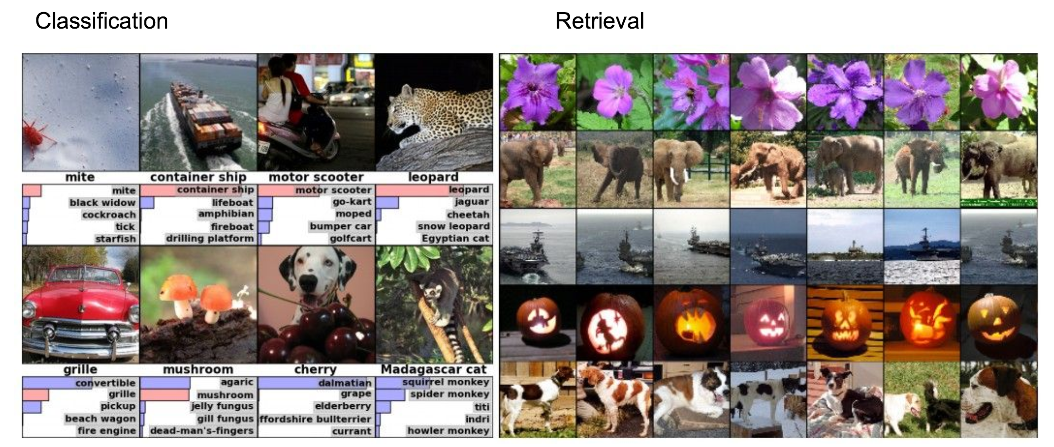
Convolutional Neural Networks (CNNs)
[Krizhevsky 2012]

Slide 33

Convolutional Neural Networks (CNNs)
[Faster R-CNN: Ren, He, Girshick, Sun 2015] [Farabet et al., 2012]

Slide 34





ATARI game playing, Mnih 2013
VizDoom
StarCraft
AlphaGo, Silver et al 2016
….

Slide 35

What changes with CNNs
vector describing various image statistics
f
Feature Extraction
1000 numbers, indicating class scores
training
[224x224x3]
f
1000 numbers, indicating class scores
training
[224x224x3]

Slide 36

Feature visualization

Slide 37

Feature extraction with CNNs
1. Train on a large dataset (eg. ImageNet)
2. Small dataset:
feature extractor
Freeze these
Feature vector

Slide 38













Matrix factorization
d
d
2
4
5
5
4
1
5
2
1
5
4
4
2
4
5
1

Slide 39

Enhance CF with CNNs
VBPR: Visual Bayesian Personalized Ranking from Implicit Feedback He, etl AAAI 2015

Slide 40
CNNs for music feature extraction
Idea: Use DL to learn the item factors e.g. music
Map audio to lower dimensional space where it can be used directly for recommendation
Useful in recommending music from the long tail (not popular)
A solution to the cold start problem

Slide 41

CNNs for music feature extraction
Item factors
A. van den Oord, S. Dielmann, B. Schrauwen Deep content-based music recommendation NIPS 2014

Slide 42
DL for vision, audio and text
Spectrograms
Text
Images

Slide 43
DL for vision, audio and text
Text

Slide 44
















Recurrent Neural Networks
Next hidden state depends on the input and the actual hidden state (recurrence)
“Vanilla” RNN
RNNs are FFN with “Infinite Depth”
Weights are tied at each time-step
Trained with Backpropagation Through Time (BPTT)
Basically backprop truncated to a finite number of steps

Slide 45
Problems of RNNs
Exploding gradients due to recurrence
If the spectral radius (largest eigenvalue) of W_{hh} is > 1
Vanishing gradients
Gradients of earlier stages vanish
If the spectral radius (largest eigenvalue) of W_{hh} is < 1

Slide 46
Gated units
Long Short-Term Memory (LSTM)
Memory cell (ct) is the mix of
its previous value (governed by the forget gate (ft))
the cell value candidate (governed by the input gate (it))
Cell value candidate (c ̂t) depends on the input and the previous hidden state
Hidden state is the memory cell regulated by the output gate (ot)
No vanishing/exploding gradients
Gated Recurrent Unit (GRU)
Hidden state is the mix of
the previous hidden state
the hidden state candidate (h ̂_{t})
governed by the update gate (z_{t})
Hidden state candidate depends on the input and the previous hidden state through a reset gate (r_{t})
Similar performance
Less calculations

Slide 47












Gated units
Long Short-Term Memory (LSTM)
Gated Recurrent Unit (GRU)

Slide 48

RNN configurations
E.g. Session-based recommendation

Slide 49
RNN configurations
E.g. image captioning

Slide 50
RNN configurations
E.g. sentiment analysis

Slide 51
RNN configurations
Sequence-to-sequence e.g. machine translation

Slide 52
RNN configurations
E.g. per-frame video classification

Slide 53
Session-based recommendation
Recommender systems in real-life
Challenges
Explicit feedback → implicit feedback
Slowly evolving item catalog → fastly changing itemset
User profile → separate sessions
Current solutions
Implicit feedback based methods
CF methods over attributes (e.g. tags) –-> user influenced by what she sees
Item-to-item recommendations
Session-based recommendation
Permanent (user) cold start
User identification / changing goal or intent / disjoint sessions
Common workaround: Item-to-session recommendations
Next event prediction

Slide 54
Session modeling with RNNs [Hidasi et al, 2015]
Input: actual item of session
Output: score on items for being the next in the event stream
GRU based RNN
Vanilla RNN is worse
LSTM is slower (same accuracy)
Optional embedding and feedforward layers
Better results without
Number of layers
1 gave the best performance
Sessions span over short timeframes
No need for modeling on multiple scales
Output: scores on all items
Feedforward layers
(optional)
GRU layer
…
GRU layer
GRU layer
Embedding layers
(optional)
Input: actual item, 1-of-N coding

Slide 55
Session modeling with RNNs
Pairwise ranking loss
BPR (Bayesian Pairwise Ranking)
TOP1
Regularized approximation of the relative rank of the positive item
Negative item sampling in output
Output: scores on all items
Feedforward layers
(optional)
GRU layer
…
GRU layer
GRU layer
Embedding layers
(optional)
Input: actual item, 1-of-N coding

Slide 56

Offline experiments
Data | Description | Items | Train |  | Test
 |  |  | Sessions | Events | Sessions | Events
RSC15 | RecSys Challenge 2015. Clickstream data of a webshop. | 37,483 | 7,966,257 | 31,637,239 | 15,324 | 71,222
VIDEO | Video watch sequences. | 327,929 | 2,954,816 | 13,180,128 | 48,746 | 178,637

Slide 57





Offline experiments
GRU4Rec (100, units c.-entropy)
GRU4Rec (1000 units, c.-entropy)
GRU4Rec (100, units c.-entropy)
GRU4Rec (1000 units, TOP1)
GRU4Rec (1000 units, TOP1)
GRU4Rec (1000 units, BPR)
GRU4Rec (1000 units, BPR)
GRU4Rec (100 units, TOP1)
GRU4Rec (100 units, TOP1)
GRU4Rec (100 units, BPR)
GRU4Rec (100 units, BPR)
Session pop
Session pop
Item-kNN
Item-kNN
Pop
BPR-MF
Pop
BPR-MF
GRU4Rec (100, units c.-entropy)
GRU4Rec (1000 units, c.-entropy)
GRU4Rec (100, units c.-entropy)
GRU4Rec (1000 units, TOP1)
GRU4Rec (1000 units, TOP1)
GRU4Rec (1000 units, BPR)
GRU4Rec (1000 units, BPR)
GRU4Rec (100 units, TOP1)
GRU4Rec (100 units, TOP1)
GRU4Rec (100 units, BPR)
GRU4Rec (100 units, BPR)
Session pop
Session pop
Item-kNN
Item-kNN
Pop
BPR-MF
Pop
BPR-MF

Slide 58
Feature rich session-based recommendation
ItemID (next)
Motivation: user influencing factors for more accurate session modeling (video thumbnails, product images and text descriptions)
Naïve solutions (feature only, concatenation) fail → Parallel-RNNs:
Concatenate the hidden layers of the subnetworks
Subnets capture different aspects of the session
Different training strategies (simultaneous, alternating, residual, interleaving)
One-hot vector
Scores on items
f()
Weighted output
w_{ID}
w_{image}
Subnet output
Subnet output
GRU layer
GRU layer
One-hot vector
Image feature vector
ItemID

Slide 59




Experiments with video thumbnails
Online video site
712,824 items
Training: 17,419,964 sessions; 69,312,698 events
Test: 216,725 sessions; 921,202 events
Target score compared to only the 50K most popular items
Feature extraction
GoogLeNet (Caffe) pretrained on ImageNet dataset
Features: values of the last avg. pooling layer
Dense vector of 1024 values
Length normalized to 1

Slide 60

Experiments with video thumbnails
Method | #Hidden units | Recall@20 | MRR@20
Item-kNN | - | 0.6263 | 0.3740
ID only | 100 | 0.6831 | 0.3847
ID only | 200 | 0.6963 | 0.3881
Feature only | 100 | 0.5367 | 0.3065
Concat | 100 | 0.6766 | 0.3850
P-RNN (naive) | 100+100 | 0.6765 | 0.4014
P-RNN (res) | 100+100 | 0.7028 | 0.4440
P-RNN (alt) | 100+100 | 0.6874 | 0.4331
P-RNN (int) | 100+100 | 0.7040 | 0.4361

Slide 61

Experiments on text
Classified ad site
339,055 items
Train: 1,173,094 sessions; 9,011,321 events
Test: 35,741 sessions; 254,857 events
Target score compared with all items
Multilanguage user generated titles and item descriptions
Feature extraction
Concatenated title and description
Bi-grams with TF-IDF weighting
Sparse vectors of 1,099,425 length; 5.44 avg. non-zeroes

Slide 62

Word embeddings with Word2Vec
Build dense representations of words that preserve semantics
Contextual Bag-of-words (CBOW)
predict a word give its surrounding words (context)
Skip-gram
Predict a word given its context
Every word has 2 vectors (input and output)

Slide 63

Word2Vec preserves semantics

Slide 64


Prod2vec [Grbovic et al., 2015]
Idea: Use word embeddings to model item purchase behavior
Session-based recommendation:
Train item embeddings from sequences
Recommend the next-item with KNN
Extension to metadata [Vasile et al., 2016]

Slide 65




Autoencoders

Slide 66


Personalized Autoencoders [Wu et al, 2016]

Slide 67

Other DL in RecSys
[Deep Neural Networks for YouTube Recommendations, Covington et a. 2016]

Slide 68

Other DL in RecSys
[Wide & Deep Learning, Cheng 2016]

Slide 69






Frameworks for DL
Lasagne
Caffe
Torch
Theano
TensorFlow
Keras
Mxnet
chainer
Nervana’s Neon
Microsoft’s CNTK
Deeplearning4j
...

Slide 70

Deep Learning and RecSys
Not - yet :-) - revolutionary as in other fields (vision, text, speech)
Remember: DL works well when data has structure!
Sequential recommendation (RNNs, Prod2Vec)
“mimic” MF with autoencoders
complex feature extraction
DLRS workshop @ ACM RecSys!

Slide 71
Credits
Most of the material in this slideshow was taken from some other awesome presentations:
“Deep Learning to the Rescue”, Balazs Hidasi, Budapest Recys Meetup 2016
“Deep Learning for Recsys”, Alexandros Karatzoglou, Budapest Recys Meetup 2016
Slides from the Bay Area Deep Learning school 2016 (Andrej Karpathy, Richard Socher and Quoc V.Le)

Slide 72
References
DL for RecSys:
VBPR: Visual Bayesian Personalized Ranking from Implicit Feedback, He et al., 2016
Deep content-based music recommendation, van den Oord et al., 2013
Session-based Recommendations with Recurrent Neural Networks, Hidasi et al., 2015
Parallel Recurrent Neural Network Architectures for Feature-rich Session-based Recommendations, Hidasi et al, 2016
E-commerce in Your Inbox: Product Recommendations at Scale, Grbovic et al., 2015
Meta-Prod2Vec - Product Embeddings Using Side-Information for Recommendation, Vasile et al., 2016
Collaborative Denoising Auto-Encoders for Top-N Recommender Systems, Wu et al., 2016
Deep Neural Networks for YouTube Recommendations, Covington et al 2016
Wide & Deep Learning, Cheng et al. 2016

Slide 73
References
CNNs
ImageNet Classification with Deep Convolutional Neural Networks, Krizhevsky et al., 2012
Going Deeper with Convolutions, Szegedy et al., ‎2014
Deep Residual Learning for Image Recognition, He et al., 2015
RNNs
Long short-term memory, Hochreiter et al., 1997
Empirical Evaluation of Gated Recurrent Neural Networks on Sequence Modeling, Chung et al., 2014

Slide 74
Some interesting resources(just a few...)
Notes on Backpropagation:
https://medium.com/@karpathy/yes-you-should-understand-backprop-e2f06eab496b#.yfvzwqilv
http://cs231n.github.io/optimization-2/
Notes on Gradient descent:
http://sebastianruder.com/optimizing-gradient-descent/
Notes on RNNs:
http://karpathy.github.io/2015/05/21/rnn-effectiveness/
Online courses:
http://cs231n.stanford.edu/

Slide 75
Thank you!
Any (deep) question?

Slide 76
Backup slides

Slide 77



Convolutional Networks
Standford CS231n: Convolutional Neural Networks for Visual Recognition

Slide 78

Convolutional Networks

Slide 79

Convolutional Networks

Slide 80

Convolutional Networks

Slide 81

Convolutional Networks

Slide 82

Convolutional Networks

